Slide 1
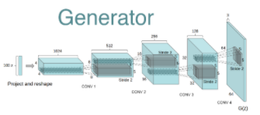
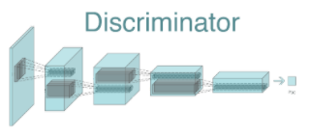
DCGAN Overall Architecture
Mapping function
Transposed convolution
generated image
(mapped distribution)
Latent variable (noise)
Celeb
DATASET
3 * 64 * 64
GENERATOR
DISCRIMINATOR
FAKE for 0
REAL for 1
Loss: D(x) + (1-D(G(z)))
Train D
Train G

